Slide 1


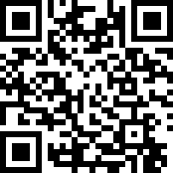
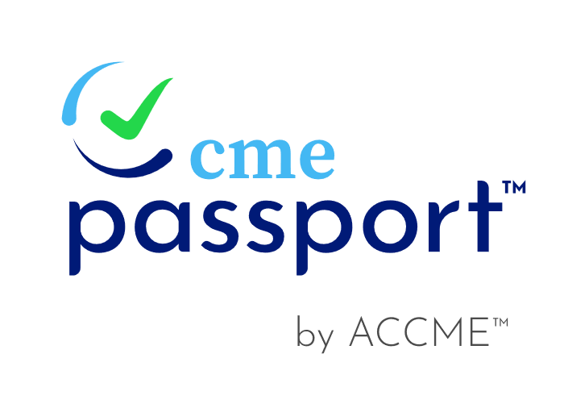
CME Passport: Claim Your Profile Your CME, Automatically Tracked
Automatically see CME reported by accredited providers with your permission
One transcript for licensure and board certification
No more manual tracking or PDF certificates
Free. Secure. Trusted by regulators.
Claim your profile today at cmepassport.org.
Used by state medical and certifying boards to verify CME completion.

