Slide 1
Annual reporting office hours SESSION 1 January 28, 2025 1:00-2:00PM CT
Notes:
-Live demonstration of PARS w/ test provider
-Note timing of system updates—notifications disappear after 5 mins, dashboard refreshes every 24hrs

Slide 2
Steps to complete annual reporting by 3/31:
Accept the terms of the ACCME annual agreement.
Enter all activities that started in 2024 and close all activities that also ended in 2024.
If you provide enduring material activities, update the cumulative learner counts* as of December 31, 2024.
Complete and submit your Program Summary.
Review and update your contact information.
*Cumulative learner counts should include all learners that participated in the activity from the start date (which may be prior to 2024) to either the end date of the activity or 12/31/24, whichever comes first.

Slide 3
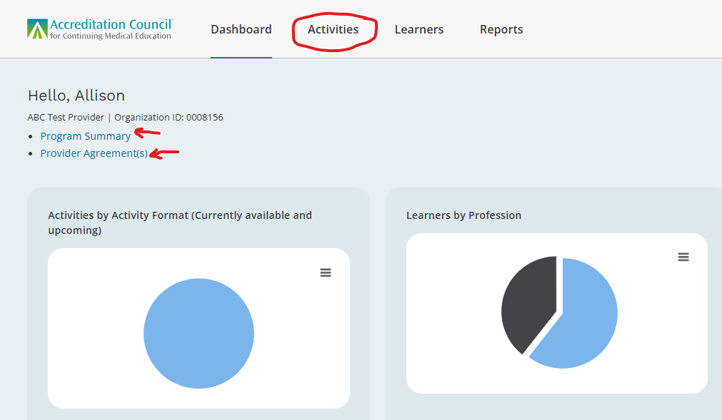
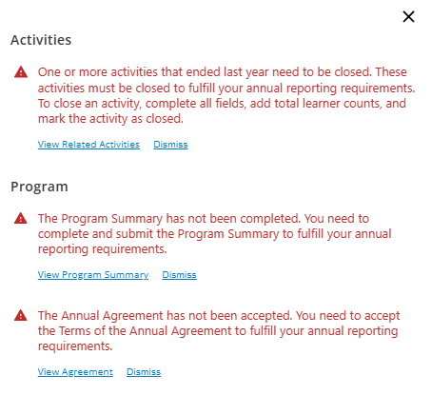
PARS Dashboard and Demo

Slide 4
ACTIVITY REPORTING: COMMON QUESTIONS

Slide 5
What is the difference between a Regularly Scheduled Series (RSS) and a repeated Course?
Activity reporting: common questions
RSS
Repeated Course
Planned as a series
May have multiple sessions in the series
Series = Activity
For internal staff, so generally the same learners each time
Example: Grand Rounds
Planned as a single course
Same content is offered multiple times
Each occurrence = Activity
Different learners each time
Example: ACLS, PALS
Notes:
A Regularly scheduled series (RSS) is a live activity planned as a series with multiple, ongoing sessions, e.g., offered weekly, monthly, or quarterly. An RSS is primarily planned by and presented to the accredited organization's professional staff and generally targets the same audience over the whole series. Examples include grand rounds, tumor boards, and morbidity and mortality conferences.
Live activities where the same content is offered multiple times for different audiences should be reported as separate live courses and not RSS.
For example: Internal Medicine Grand Rounds is planned as a 12-month activity from July 1 to June 30 each year. This activity meets for one hour each week. The start date should be entered as 07/01/XXXX and the end date should be entered as 06/30/XXXX. In PARS, the series should be entered as one activity with 52 credits. If 20 physicians participated in each session, total physician learners would be 1,040 (20 learners/session x 52 sessions) for that single activity.

Slide 6
I plan activities based on an academic year. Do I have to report them on a calendar year basis?
Activity reporting: common questions
No! Each activity should appear once in PARS.
Enter the actual Start and End date.
Close the activity in the year in which it ends.
Example: An RSS runs from July 1, 2024 – June 30, 2025. Enter the RSS when it starts in 2024, update the learner counts and close the activity when it ends in 2025 (but no later than March 31, 2026)
Except for Enduring Materials, activities must be entered once every 12 months
Example: QI/PI CME, Learning from Teaching activities

Slide 7
When should I enter my total learner counts?
Activity reporting: common questions
Enduring Materials:
At a minimum, once per year before March 31
Enter cumulative learner counts
Cumulative learner counts should include all learners that participated in the activity from the start date (which may be prior to 2024) to either the end date of the activity or 12/31/24, whichever comes first.
All other activity types:
As soon as possible after the activity end date
Notes:
Cumulative learner counts should include all learners that participated in the activity from the start date (which may be prior to 2024) to either the end date of the activity or 12/31/24, whichever comes first.

Slide 8
Can I use the Excel template to batch update learner counts and close my activities without overwriting other data elements for that activity?
Activity reporting: common questions
Yes!
Check ACCME’s website for instructions and templates for the Excel Batch Upload process to “Update Learners and Close.”

Slide 9
Should I report an enduring material activity that did not have any learners?
Activity reporting: common questions
Yes!
Report any activity that was available during 2024 even if the learner counts are zero.

Slide 10
Do I count learners that did not claim credit?
Activity reporting: common questions
Yes!
Include anyone who completed the activity, even if they did not claim credit.
Do not include learners that purchased or signed up for the activity but did not participate.

Slide 11
Do I have to report individual learner credit data for physicians who participated in my activities?
Activity reporting: common questions
This is not an annual reporting requirement but is a feature of PARS that is available to you.
We encourage you to report individual learner credit! Doing so benefits the CME community by:
reducing the burden on physicians
better serving our accredited provider community
meeting the needs of credentialing, certifying, and licensing authorities
increasing the value of accredited CME
Notes:
https://accme.org/news/reduce-your-physicians-reporting-burden-by-entering-learner-credit-data-in-pars/

Slide 12
How do I report a commercial support grant received for more than one activity?
Activity reporting: common questions
Allocate the amount received across the activities that received funding.
Complete commercial support fields for each activity.
Reported at the activity level.
Notes:
Commercial support information is reported at the individual activity level.
Commercial Support Received? Indicate whether commercial support was received for this activity by clicking “Yes” or “No”. You should check “Yes” for this question if support was received regardless of whether it was paid directly to your organization, as the Accredited Provider, or to a joint provider.
Support Source: Complete this field for each commercial supporter for your activity. Select a name from the drop-down box, or, if the commercial supporter for your activity does not appear in the drop-down, type the supporter’s name into the text field.
Monetary Support Received: Use this field to indicate the amount of monetary support received from each commercial supporter.
In-kind Support Received: Use this field to indicate the nature of any in-kind support received from each commercial supporter.

Slide 13
PROGRAM SUMMARY: COMMON QUESTIONS

Slide 14
Do I have to report Program Summary information for the calendar year?
Program summary: common questions
No!
Report data for the most recent 12-month period available:
Fiscal,
Academic,
Calendar, OR
Other
Be as consistent as possible from year to year

Slide 15
Do I have to report funds received for jointly provided activities?
Program summary: common questions
Yes!
Report the same financial data that you do for directly provided activities, even if the joint provider was the recipient of the funds.

Slide 16
What should be included in registration fees?
Program summary: common questions
Fees received from learners, including
Registration Fees
Subscription Fees
Publication Fees

Slide 17
Program summary: common questions
How is advertising and exhibit income different from commercial support?
Advertising and exhibits
opportunities for promotion
examples: advertising space, exhibit booths
reported on the Program Summary
Commercial support
given by an ACCME-defined ineligible company
used to pay all or part of the costs of a CME activity
can be monetary or in-kind
reported for each individual activity
Notes:
Advertising and exhibits are opportunities for promotion (like advertising space, exhibit booths, etc.) and not continuing medical education. Therefore, monies paid by ineligible companies to providers for these promotional opportunities are not considered to be commercial support and should be reported as advertising and exhibit income. These funds must comply with Standard 5 of the Standards for Integrity and Independence in Accredited Continuing Education.
Commercial support is defined as any monetary or in-kind contributions given by an ACCME-defined ineligible company that is used to pay all or part of the costs of a CME activity. You must report commercial support information, including the commercial support source(s) and amount received, for each individual activity that received commercial support.

Slide 18
Annual Reporting Dos and Don’ts
DO:
Check out our annual reporting web page for short video tutorials, a checklist, and templates to help you complete your annual reporting requirements.
Visit the “quick answers” section of our website and click on “Activity Data” and “Annual Reporting” for answers to frequently asked questions on those topics.
Double check the accuracy of your activity and learner data before submitting.
Enter and close your activities throughout the year to avoid last-minute data entry.
Reach out to us at datareporting@accme.org with questions.
DON’T:
Wait until the last minute. Complete your requirements as early as possible in case issues arise.
Forget to review and update your organization’s contact information.
Panic! We are here to help.
Notes:
Add link to annual reporting page in the chat: https://accme.org/annual-reporting-pars

Slide 19
THANK YOU!

